Slide 1

18CSS202J- COMPUTER COMMUNICATION

Slide 2
UNIT –V Contents
Delivery - Types ( Direct , Indirect)
Forwarding Techniques -
- Next -hop method
- Route Method
- Network specific Method
- Host specific Method
- Default Method
Forwarding Process:
Steps followed by Router

Slide 3
Routing
-Routing Table contents
-Types of Routing - Static & Dynamic
( including tables).
Autonomous system
Intradomain & Interdomain routing

Slide 4
Types of Routing.
Distance vector Routing
Link state Routing
Path vector Routing
PROBLEM SOLVING

Slide 5
RIP version 1 & RIP version2
OSPF
Comparison
EIGRP
BGP

Slide 6
22-1 DELIVERY
The network layer supervises the handling of the packets by the underlying physical networks. We define this handling as the delivery of a packet.
Topics discussed in this section:
Direct Versus Indirect Delivery

Slide 7
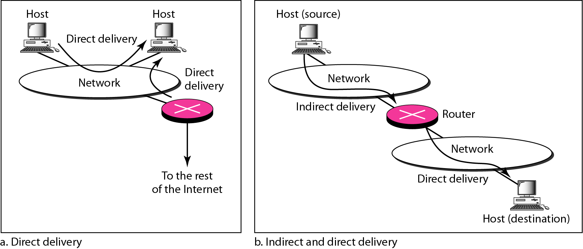

Slide 8
22-2 FORWARDING
Forwarding means to place the packet in its route to its destination. Forwarding requires a host or a router to have a routing table. When a host has a packet to send or when a router has received a packet to be forwarded, it looks at this table to find the route to the final destination.
Topics discussed in this section:
Forwarding Techniques Forwarding Process
Routing Table

Slide 9
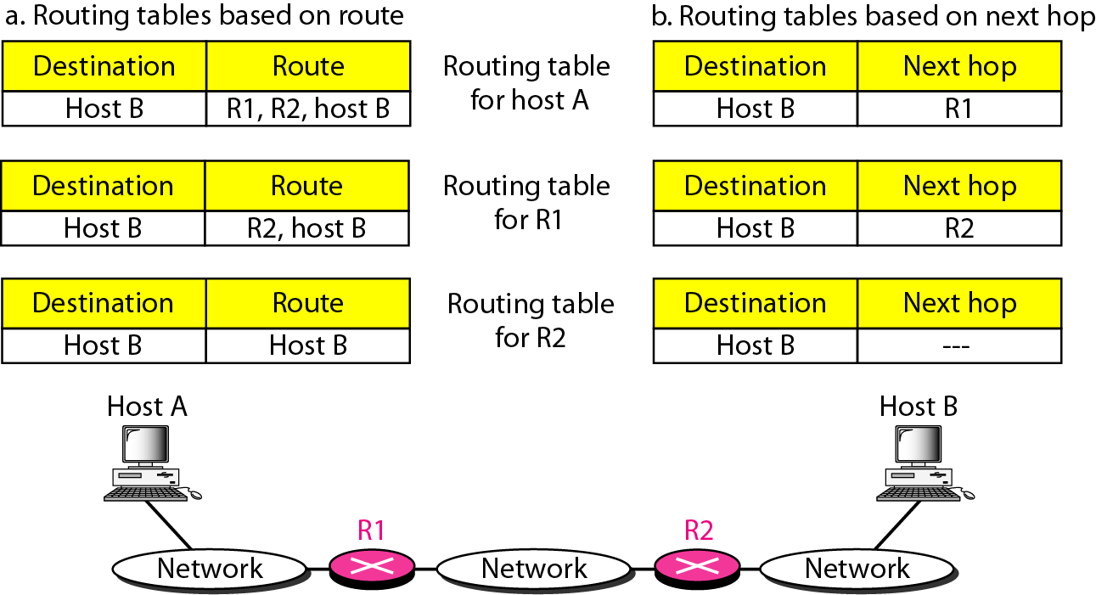
Figure 22.2 Route method versus next-hop method

Slide 10
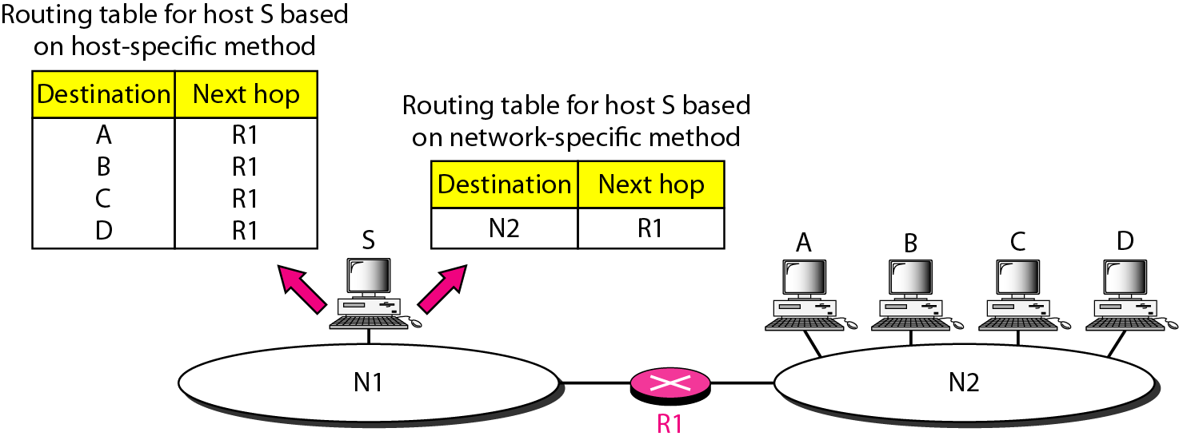
Figure 22.3 Host-specific versus network-specific method

Slide 11
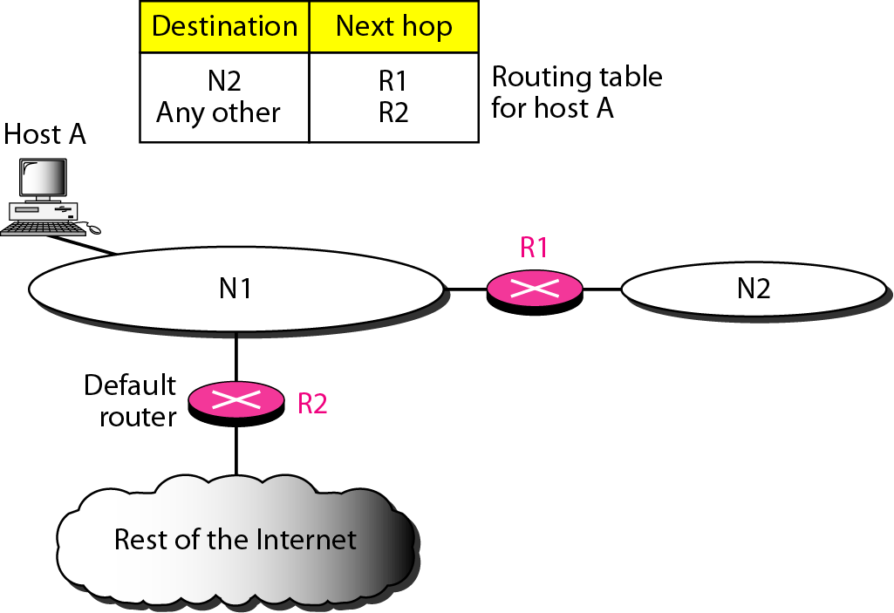
Figure 22.4 Default method

Slide 12
Default method
Host A have one entry called the default(normally defined as network address (0.0.0.0).

Slide 13
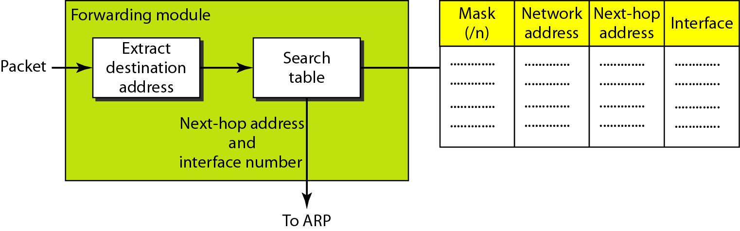
Forwarding Process
Simplified forwarding module in classless address

Slide 14
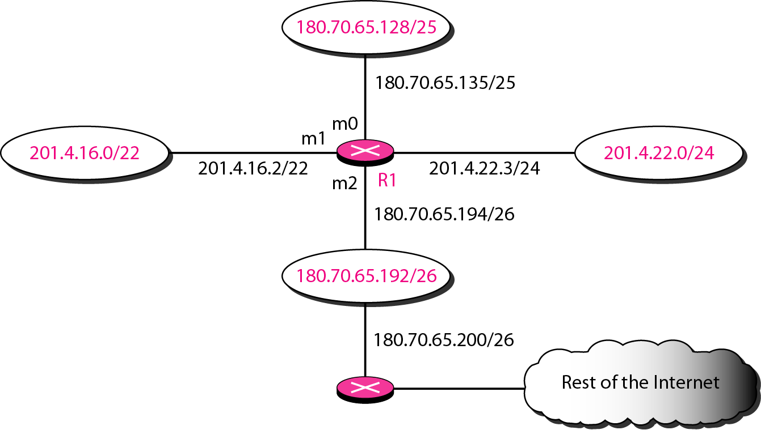
Example
Make a routing table for router R1, using the configuration in Figure.

Slide 15
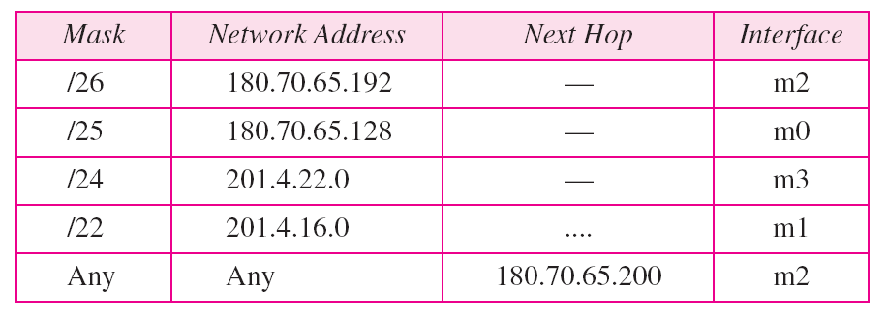
Table Routing table for router R1 in Figure

Slide 16
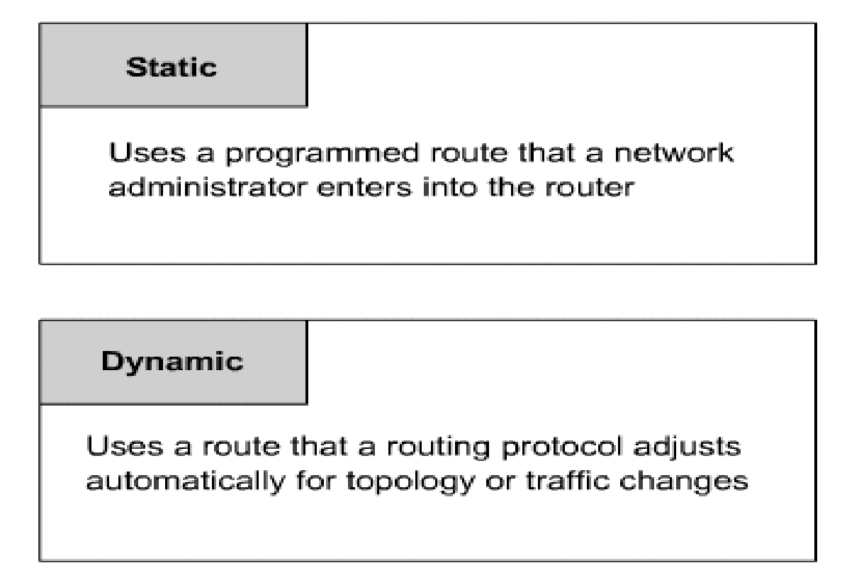

Slide 17
Static route operation
Static route operations can be divided into these three parts:
Network administrator configures the route
Router installs the route in the routing table
Packets are routed using the static route
Since a static route is manually configured, the administrator must configure the static route on the router using the ip route command.

Slide 18
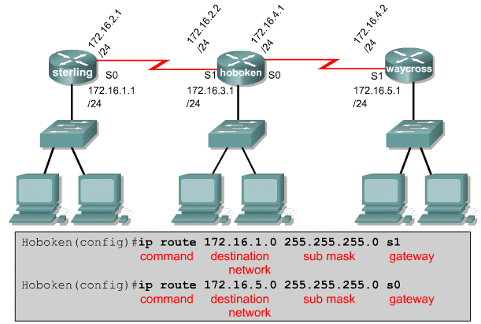

Slide 19
Verifying static route configuration
Use the following steps to verify static route configuration:
In privileged mode enter the command show running-config to view the active configuration.
Verify that the static route has been correctly entered.
Enter the command show ip route.
Verify that the route that was configured is in the routing table.

Slide 20
Advantages of static routing
-It can backup multiple interfaces/networks on a router
-Easy to configure
-No extra resources are needed
-More secure
Disadvantages of static routing
-Network changes require manual reconfiguration
-Does not scale well in large topologies

Slide 21
Dynamic Routing Table
It is updated periodically by using one of the dynamic routing protocols such as RIP, OSPF or BGP.
Whenever there is a change in the internet, such as a shutdown of a router or breaking of a link, the dynamic routing protocols update all the tables in the routers automatically.
The routers in a big internet need to be updated dynamically for efficient delivery of the IP packets.

Slide 22
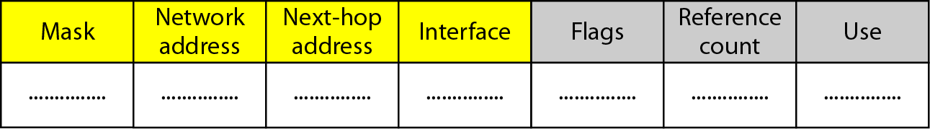
Figure Common fields in a routing table
Flags
U(up): U flag indicated the router is up and running.
G(gateway): G flag means that the destination is in another network.
H(host-specific): H flag indicates that the entry in the network address is a host specific address.
D(added by redirection)
M(Modified by redirection)
Reference count
This field gives the number of users of this route at the moment.
Use
This field shows the number of packets transmitted through this router for the corresponding destination.

Slide 23
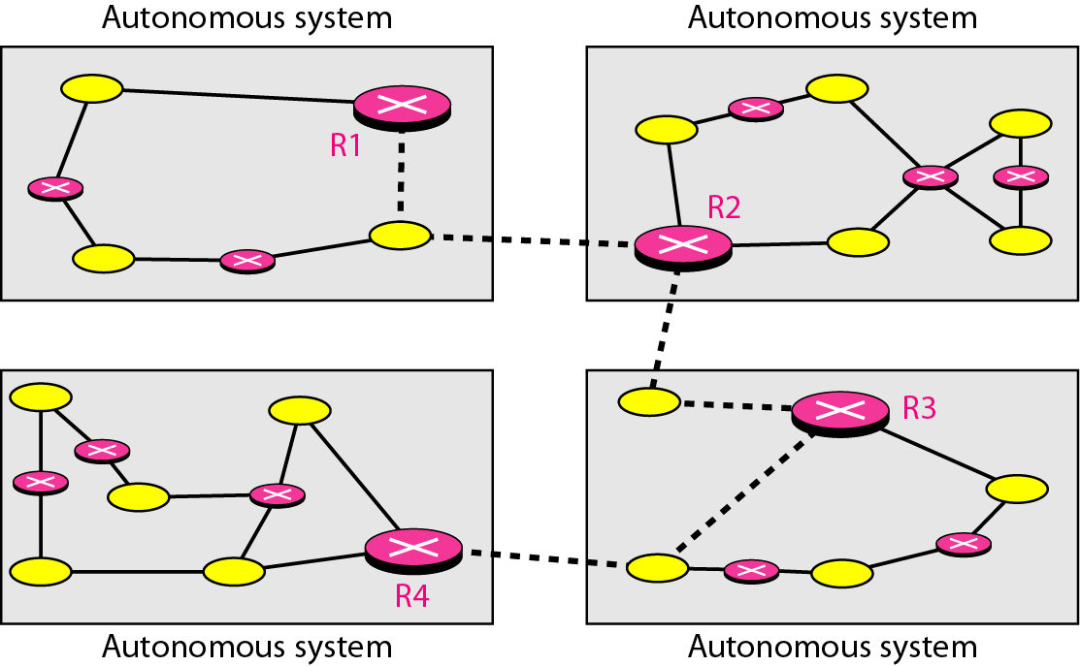
Figure 22.12 Autonomous systems

Slide 24
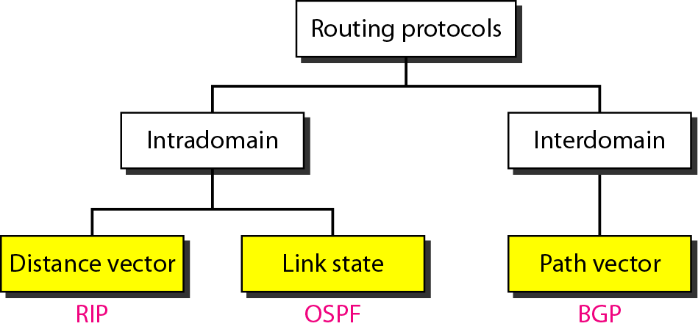
Figure 22.13 Popular routing protocols

Slide 25
Distance vector routing
The least –cost route between any 2 nodes is the route with minimum distance.
Initialization
Sharing
Updating

Slide 26
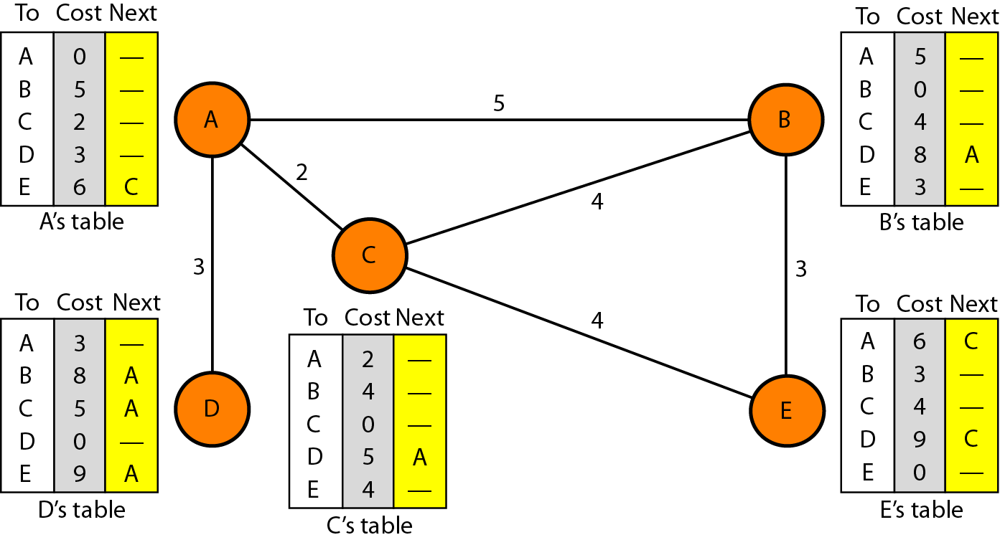
Figure Distance vector routing tables

Slide 27
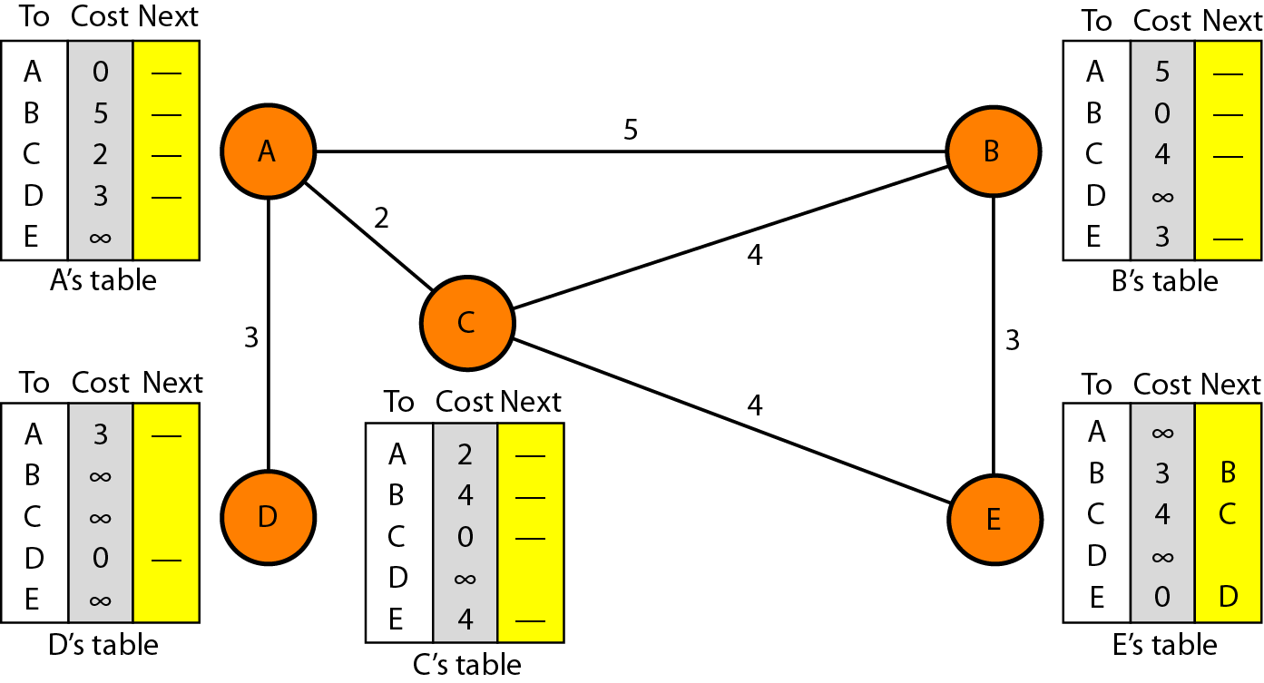
Figure Initialization of tables in distance vector routing

Slide 28
Sharing
In distance vector routing, each node shares its routing table with its immediate neighbors periodically and when there is a change.
Updating
The receiving node needs to add the cost between itself and sending node to each value in the 2nd column.
The receiving node needs to add the name of the sending node to each row as the 3rd column.
The receiving node needs to compare each row of its old table with the corresponding row of the modified version of the received table.

Slide 29
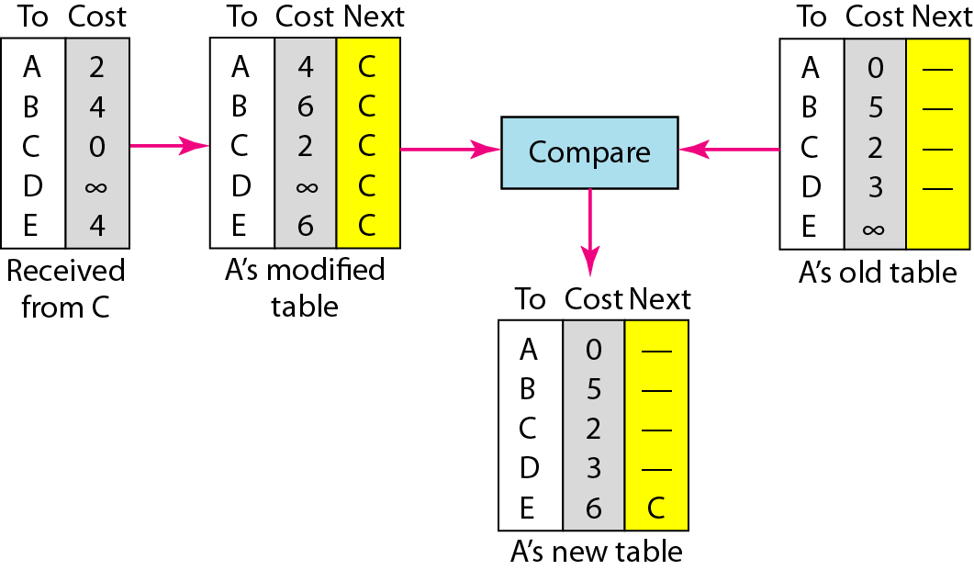
Figure Updating in distance vector routing

Slide 30
LINK STATE ROUTING
Link state routing has a different philosophy from that of distance vector routing.
In link state routing, if each node in the domain has the entire topology of the domain—the list of nodes and links, how they are connected including the
Type
Cost (metric)
The condition of the links (up or down)—the node can use the Dijkstra algorithm to build a routing table.

Slide 31
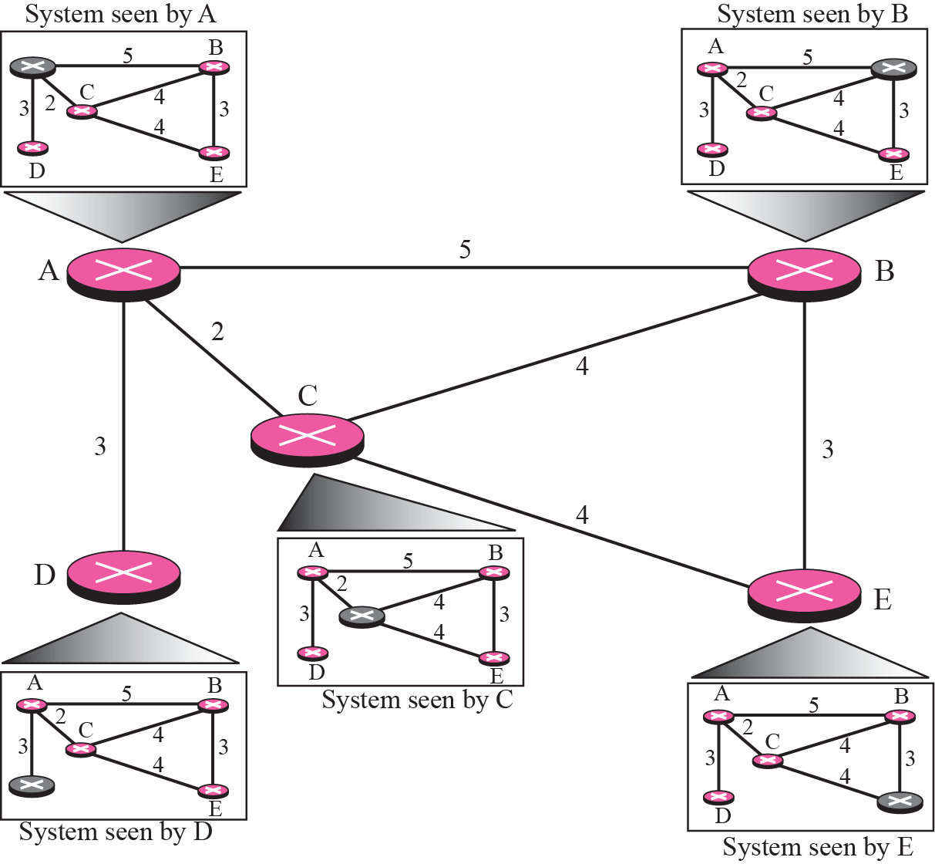
Concept of Link state routing

Slide 32
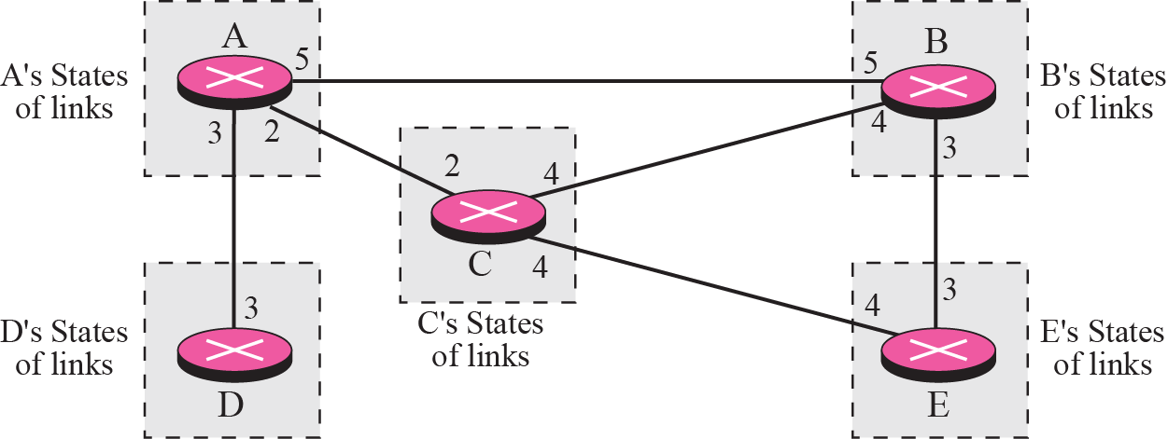
Link state knowledge

Slide 33
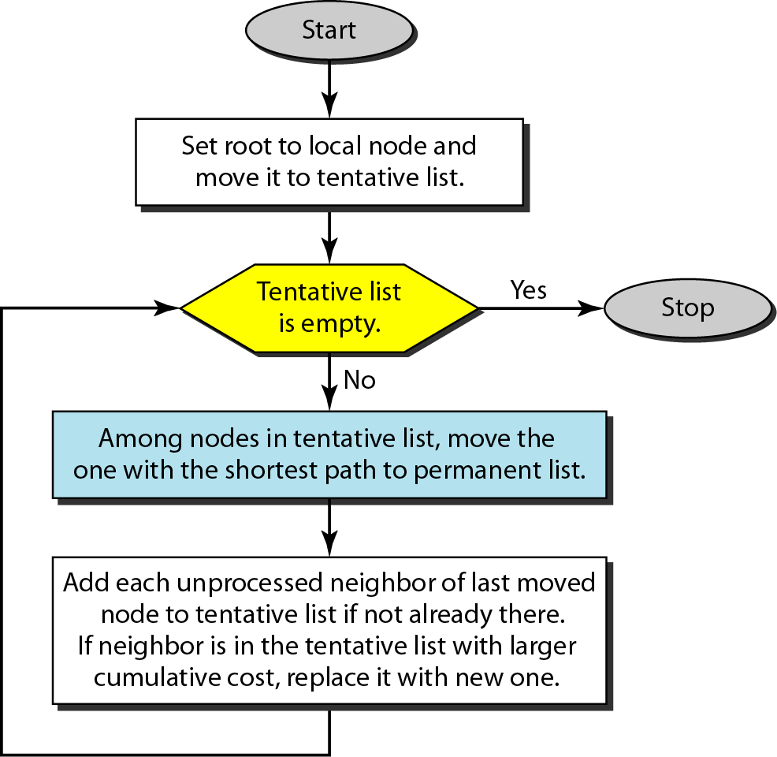
Dijkstra algorithm

Slide 34
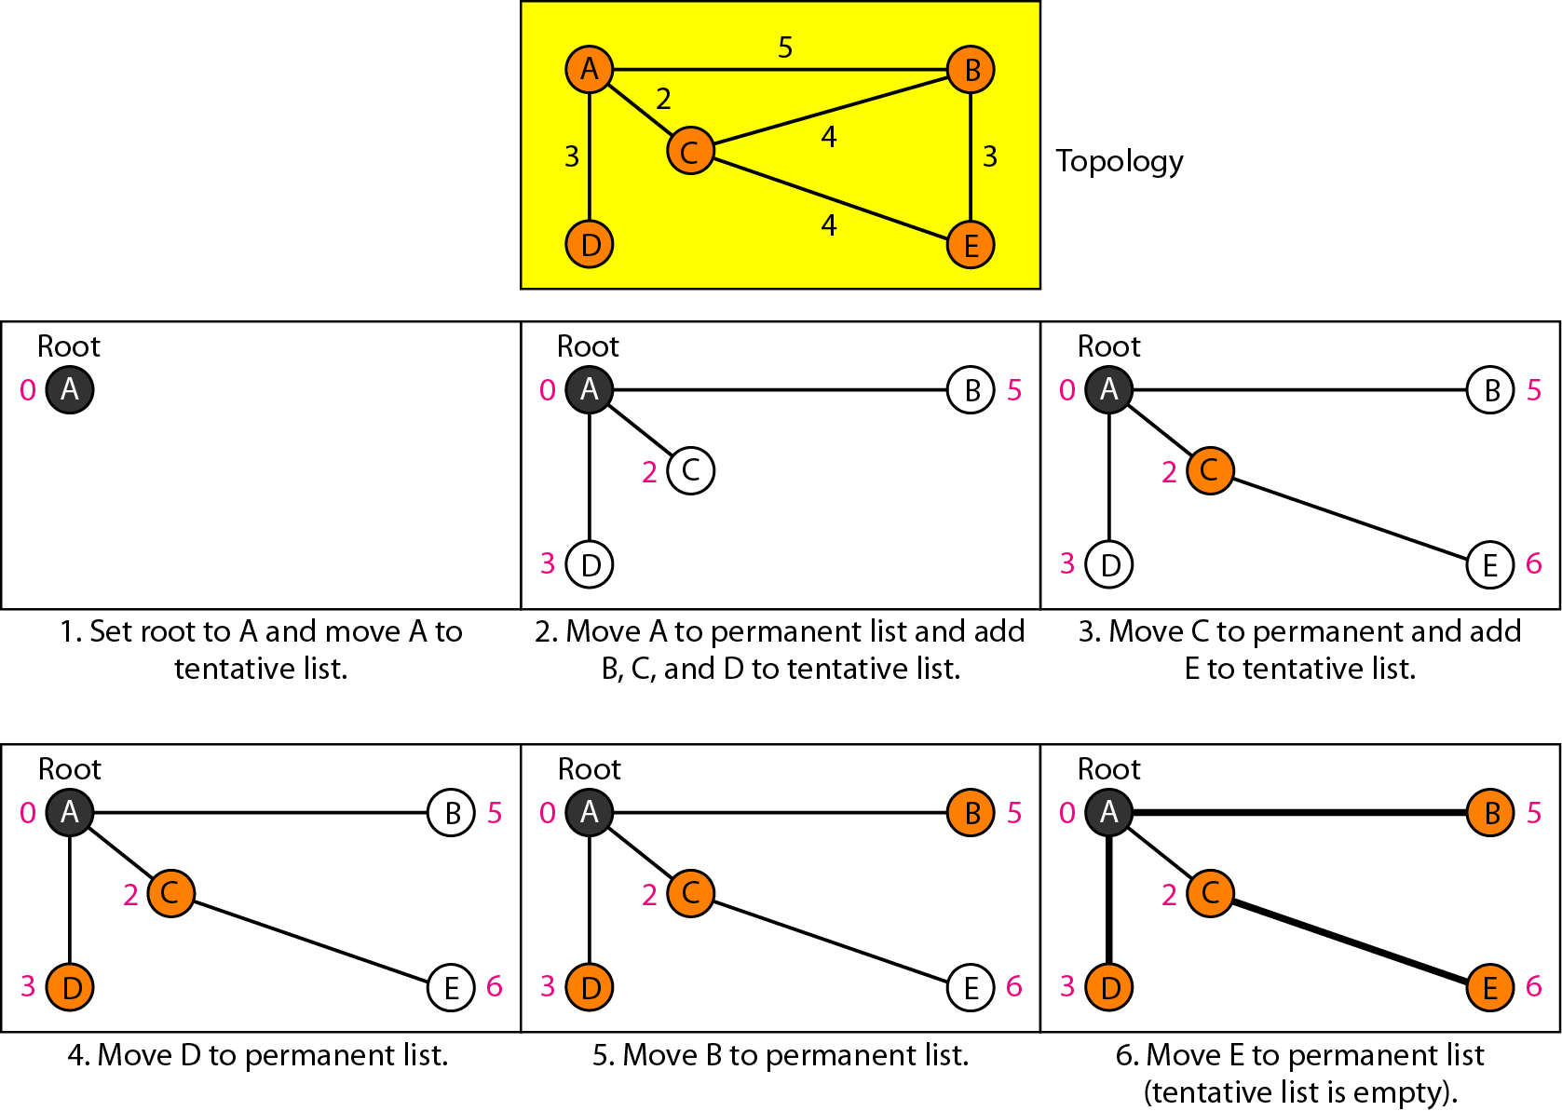
Example of formation of shortest path tree

Slide 35
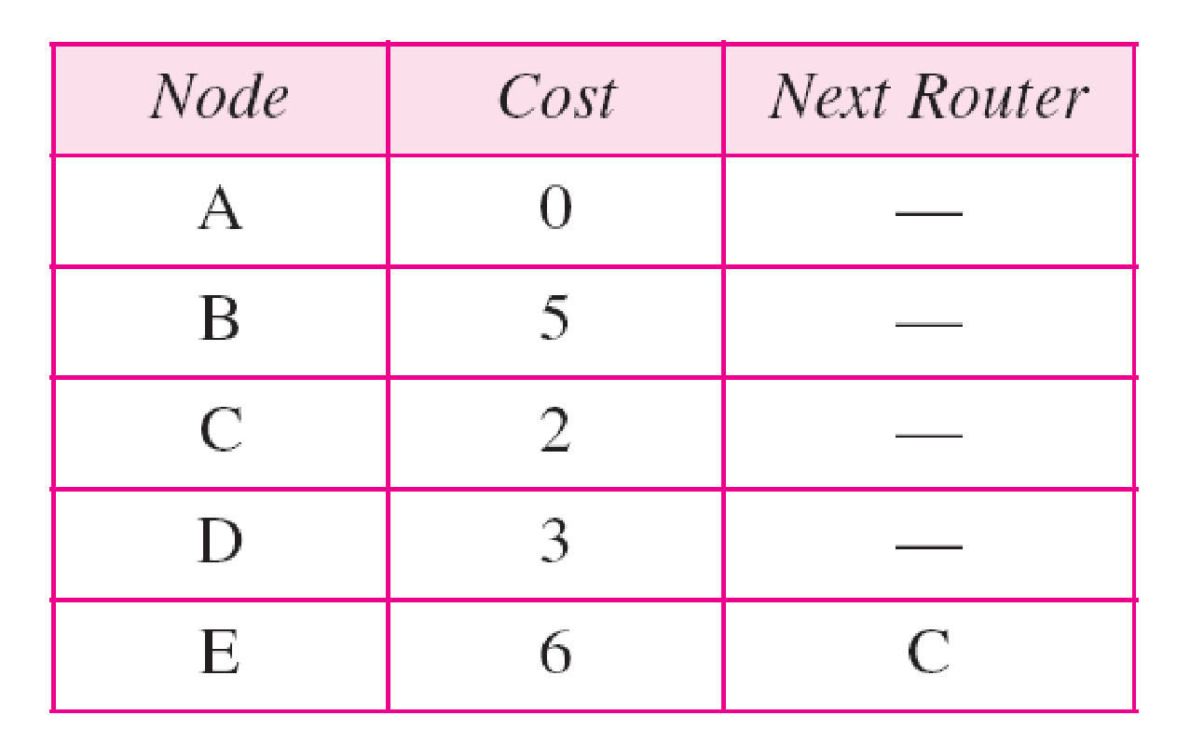
Routing table for node A

Slide 36
Building Routing Tables
Creation of the states of the links by each node, called the link state packets (LSP)
Distribution of LSPs to every other routers, called flooding (efficiently)
Formation of a shortest path tree for each node
Calculation of a routing table based on the shortest path tree

Slide 37
PATH VECTOR ROUTING
Distance vector and link state routing are both interior routing protocols. They can be used inside an autonomous system.
Both of these routing protocols become intractable when the domain of operation becomes large.
Distance vector routing is subject to instability if there is more than a few hops in the domain of operation.
Link state routing needs a huge amount of resources to calculate routing tables. It also creates heavy traffic because of flooding.
There is a need for a third routing protocol which we call path vector routing.

Slide 38
The principle of path vector routing is similar to that of distance vector routing.
In path vector, we assume that there is one node in each AS that acts on behalf of the entire AS. This is called as speaker node.
The speaker node in an AS creates a routing table and advertises it to speaker nodes in the neighboring ASs.
A speaker node advertises the path, not the metric of the nodes, in its AS or other ASs.
The idea is the same as for DV routing except that only speaker nodes in each AS can communicate with each other

Slide 39
Initialization
Each speaker node can know only the reachability of nodes inside its AS.
Node A1 is the speaker node for AS1, B1 for AS2, C1 for AS3 and D1 for AS4.
Node A1 creates an initial table that shows A1 to A5 are located in AS1 and can be reached through it.
Node B1 advertises that B1 to B4 are located in AS2 and can be reached through B1. And so on.
Sharing
A speaker in an AS shares its table with immediate neighbors.
Node A1 shares its table with B1 and C1.
Node C1 shares its table with B1 and D1.
Node B1 shares its table with A1 and C1.
Node D1 shares its table with C1.

Slide 40
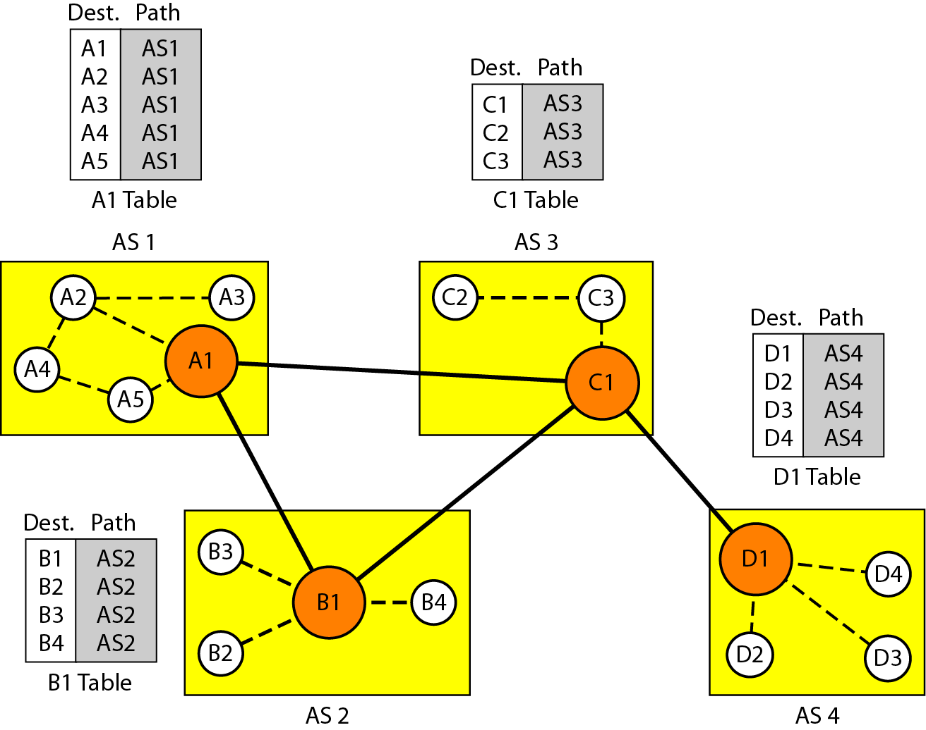
Initial routing tables in path vector routing

Slide 41
Updating
When a speaker node receives a two column table from a neighbor, it updates its own table by adding the nodes that are not in its routing table and adding its own AS and the AS that sent the table.
After a while each speaker has a table and knows how to reach node in other Ass.
Loop prevention
The instability of DV routing and the creation of loops can be avoided in PV routing.
When a router receives a message, it checks to see if its AS is in the path list to the destination.
If it is, looping is involved and the message is ignored.

Slide 42
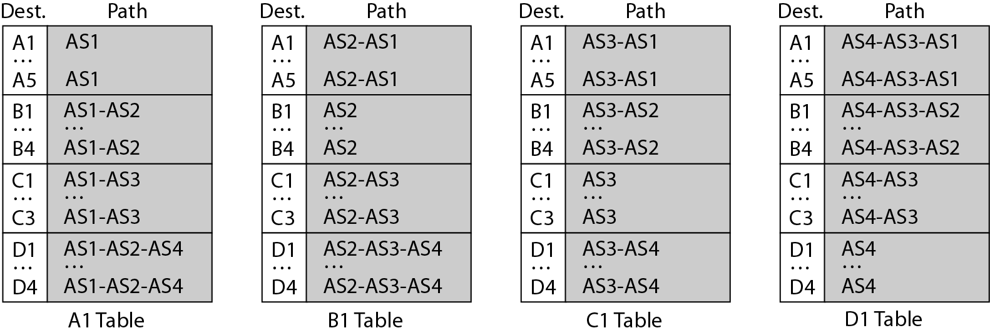
Stabilized tables for three autonomous systems

Slide 43
Policy routing
When a router receives a message, it can check the path.
If one of the AS listed in the path is against its policy, it can ignore that path and that destination.
It does not update its routing table with this path, and it does not send this message to its neighbors.
3. Optimum path
It cannot include metrics in this route because each AS that is included in the path may use a different criterion for the metric.
One system may use, RIP which defines hop count as the metric. Another may use OSPF with minimum delay defined as the metric.
The optimum path is the path that fits the organization.(Eg: AS4 to AS1)
Other criteria, such as security, safety and reliability can also be applied.

Slide 44
RIP
The Routing Information Protocol (RIP) is an intra-domain (interior) routing protocol used inside an autonomous system.
It is a very simple protocol based on distance vector routing which employ the hop count as a routing metric.
RIP prevents routing loops by implementing a limit on the number of hops allowed in a path from source to destination.
The maximum number of hops allowed for RIP is 15, which limits the size of networks that RIP can support.
A hop count of 16 is considered an infinite distance and the route is considered unreachable.

Slide 45
RIP version 1
The original specification of RIP was published in 1988 and uses classful routing.
The periodic routing updates do not carry subnet information, lacking support for variable length subnet masks (VLSM).
This limitation makes it impossible to have different-sized subnets inside of the same network class.
In other words, all subnets in a network class must have the same size.
There is also no support for router authentication, making RIP vulnerable to various attacks.

Slide 46
RIPv1 Operation
RIP defines two types of messages.
Request Message
Response Message
When a RIP router comes online, it sends a broadcast Request Message on all of its RIP enabled interfaces. All the neighboring routers which receive the Request message respond back with the Response Message containing their Routing table.
The Response Message is also unnecessarily sent when the Update timer expires. On receiving the Routing table, the router processes each entry of the routing table as per the following rules

Slide 47
If there are no route entries matching the one received then the route entry is added to the routing table automatically, along with the information about the router from which it received the routing table.
If there are matching entries but the hop count metric is lower than the one already in its routing table, then the routing table is updated with the new route.
If there are matching entries but the hop count metric is higher than the one already in its routing table, then the routing entry is updated with hop count of 16 (infinite hop). The packets are still forwarded to the old route.

Slide 48
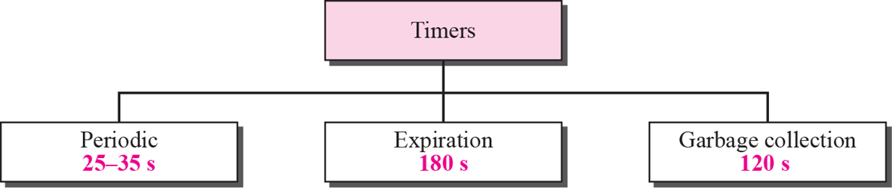
RIP Timer
_{Update Timer(Periodic)}
The update timer controls the interval between two gratuitous Response Messages.
By default the value is 30 seconds. The response message is broadcast to all its RIP enabled interface.
_{Invalid Timer(Expiration)}
The invalid timer specifies how long a routing entry can be in the routing table without being updated.
By default, the value is 180 seconds. After the timer expires the hop count of the routing entry will be set to 16, marking the destination as unreachable.

Slide 49
_{Flush Timer}
The flush timer controls the time between the route is invalidated or marked as unreachable and removal of entry from the routing table.
By default the value is 240 seconds. This is 60 seconds longer than Invalid timer.
So for 60 seconds the router will be advertising about this unreachable route to all its neighbors. This timer must be set to a higher value than the invalid timer.
_{Hold-down Timer}
The hold-down timer is started per route entry, when the hop count is changing from lower value to higher value. This allows the route to get stabilized. During this time no update can be done to that routing entry.

Slide 50
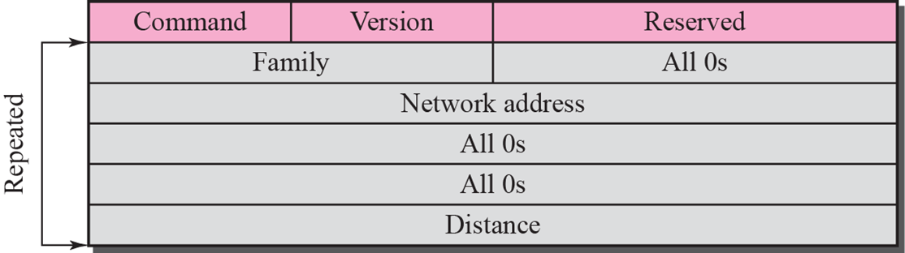
RIP message format

Slide 51
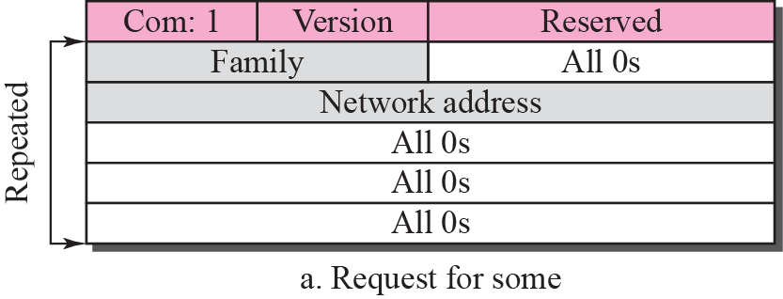
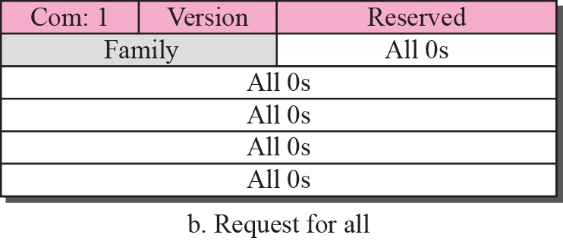
Request messages

Slide 52
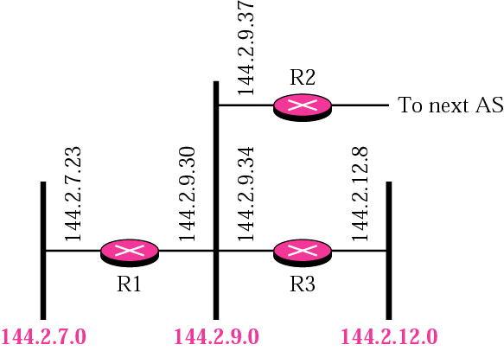
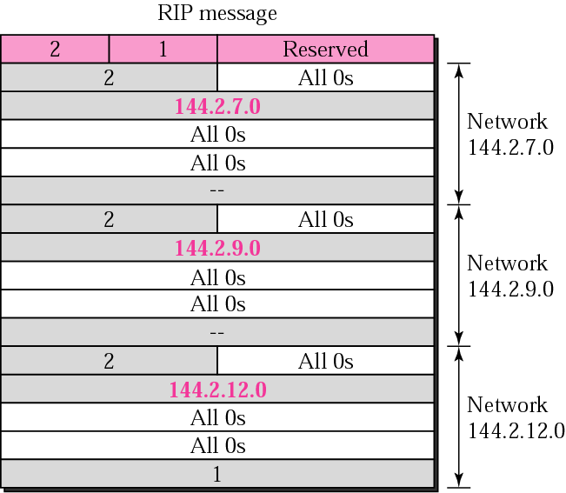
RIP message example

Slide 53
Limitations
The hop count cannot exceed 15, or routes will be dropped.
Most RIP networks are flat. There is no concept of areas or boundaries in RIP networks.
Variable Length Subnet Masks are not supported by RIP version 1 (which is obsolete).
RIP has slow convergence and count to infinity problems.

Slide 54
RIP Configuring and Commands
ip routing : enables the router
router rip : you can enter configuration commands to define the RIP process for router
network network_address : Telling the router which networks it should advertise routes for
write, write terminal : Saving configuration & view currently running configuration
ping address : To check and see if the packets are getting routed
show ip route : To view the routers current routing table
show ip rip ? : Gives information about RIP

Slide 55
RIP version 2
Due to the deficiencies of the original RIP specification, RIP version 2 (RIPv2) was developed in 1993 and last standardized in 1998. It included the ability to carry subnet information, thus supporting Classless Inter-Domain Routing (CIDR). To maintain backward compatibility, the hop count limit of 15 remained.
In an effort to avoid unnecessary load on hosts that do not participate in routing, RIPv2 multicasts the entire routing table to all adjacent routers at the address 224.0.0.9, as opposed to RIPv1 which uses broadcast. Unicast addressing is still allowed for special applications.

Slide 56
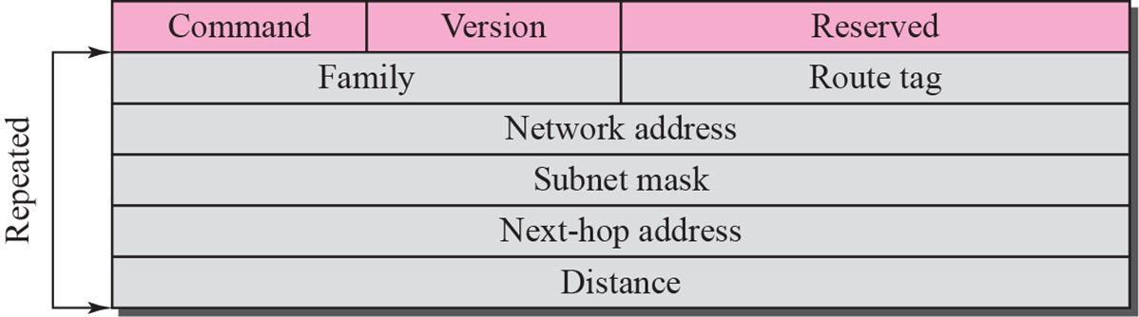
RIP version 2 format
Route tags were also added in RIP version 2. This functionality allows a distinction between routes learned from the RIP protocol and routes learned from other protocols.

Slide 57
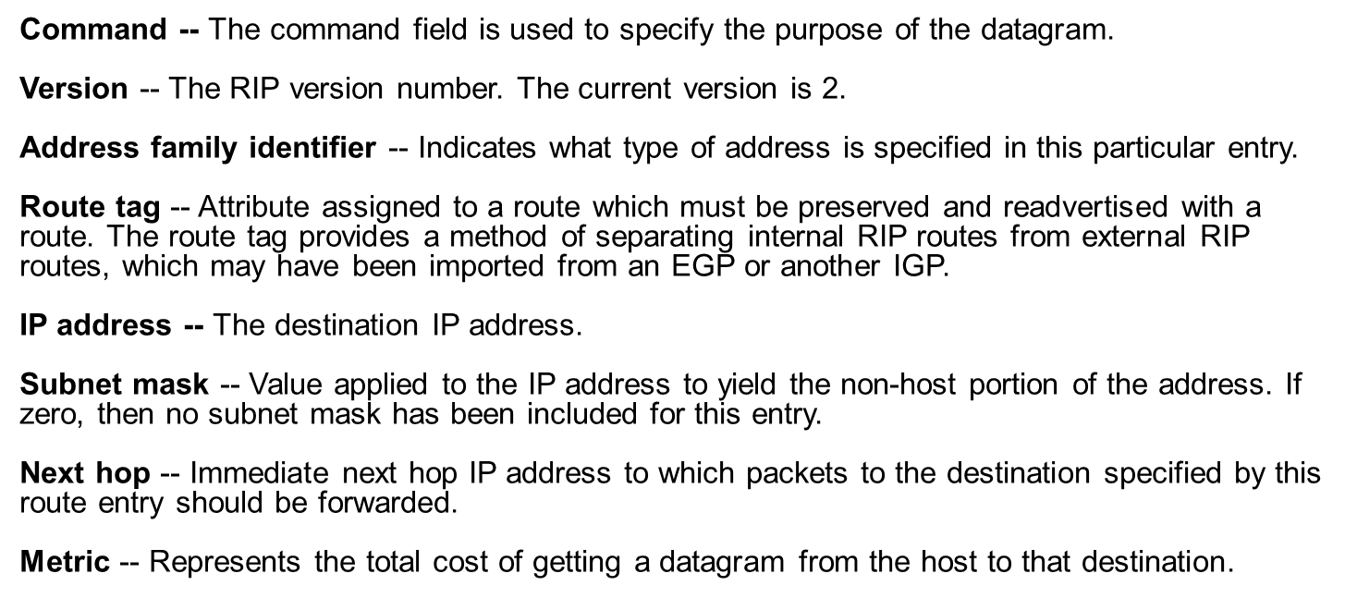

Slide 58
Limitations
RIP-2 supports generic notion of authentication, but only “password” is defined so far. Still not very secure.
RIP2 packet size increases as the number of networks increases hence it is not suitable for large networks.
RIP2 generates more protocol traffic than OSPF, because it propagates routing information by periodically transmitting the entire routing table to neighbor routers
RIP2 may be slow to adjust for link failures.

Slide 59
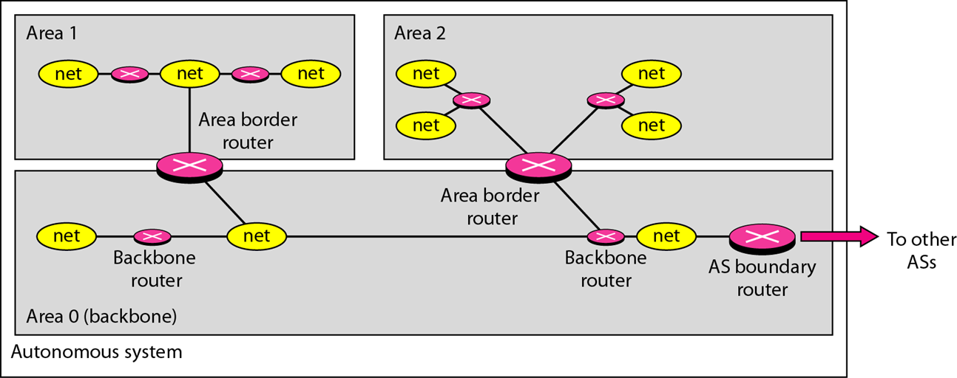
OSPF
The Open Shortest Path First (OSPF) protocol is an intra-domain routing protocol based on link state routing

Slide 60
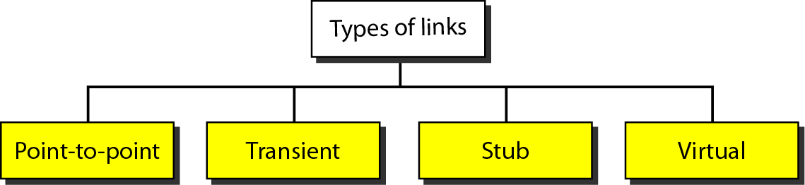
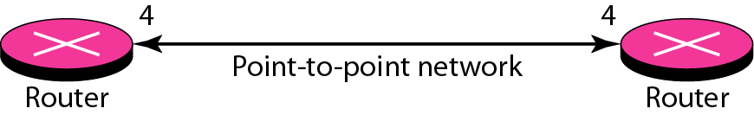
Types of links
_{Point-to-point link}
It connects two routers without any other host or router

Slide 61
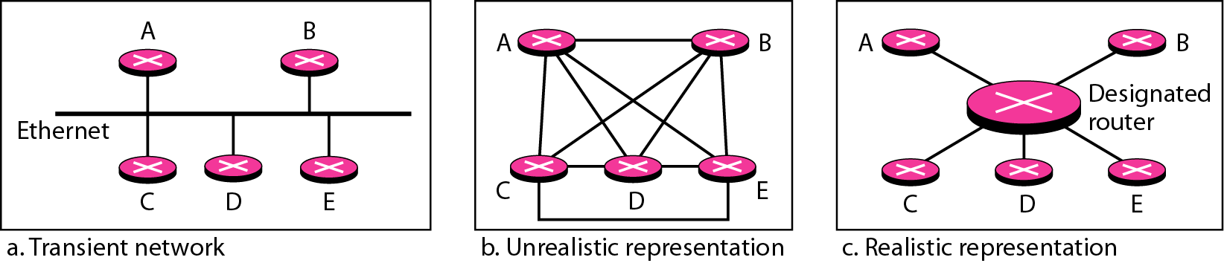

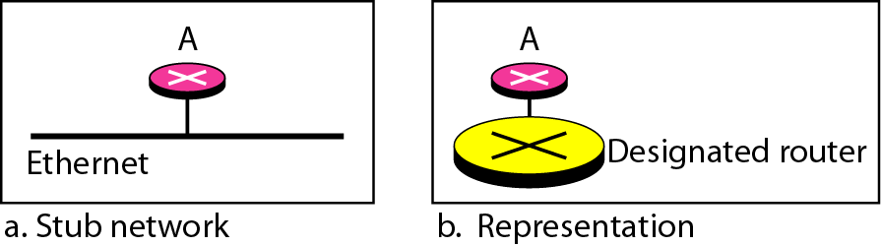
Transient link
It is a network with several routers attached to it.
It is a network that is connected to only one router.

Slide 62
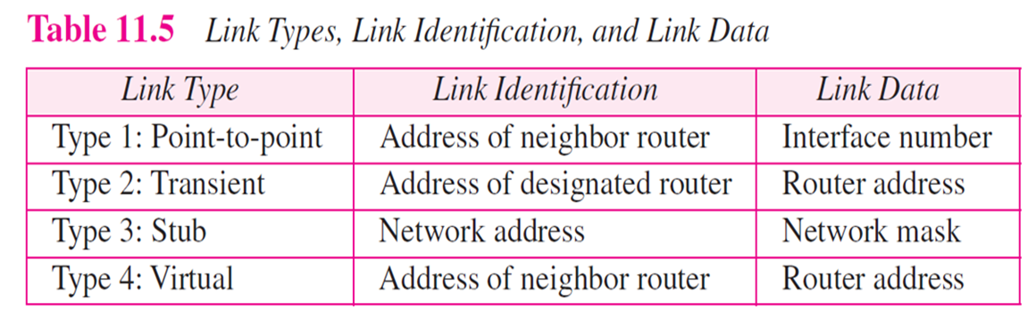
Virtual link
When the link between two routers is broken, the administration may create a virtual link between them.

Slide 63
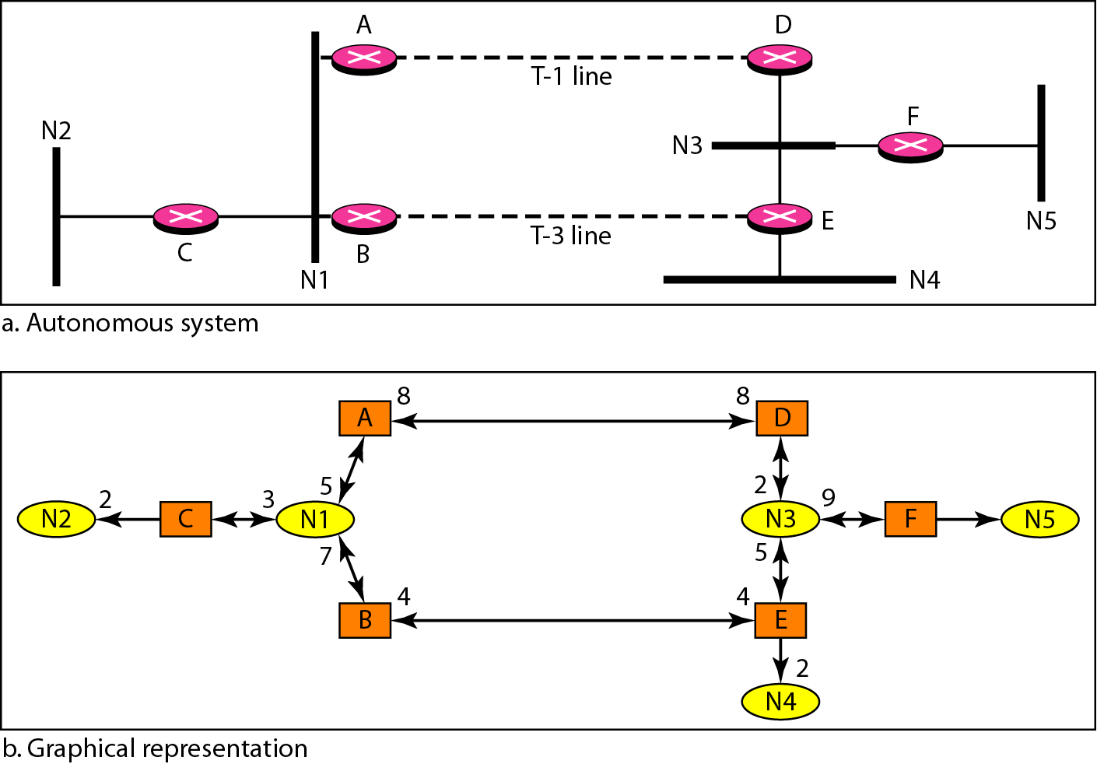
Example of an AS and its graphical representation in OSPF

Slide 64
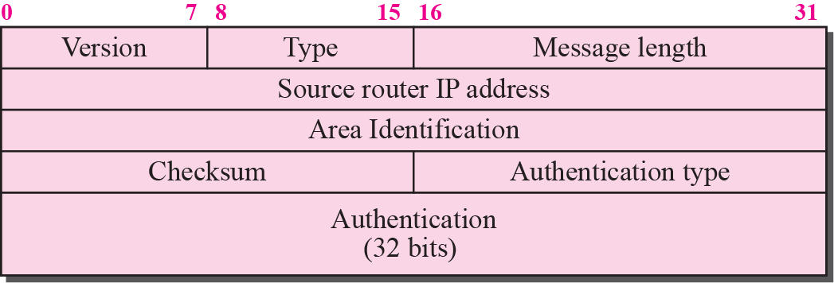
OSPF common header

Slide 65
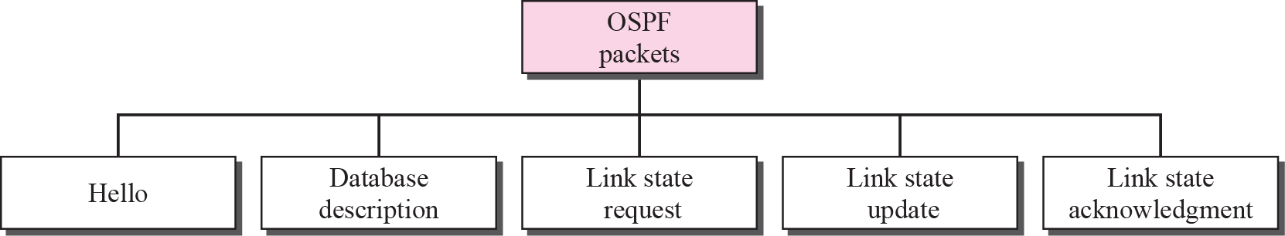
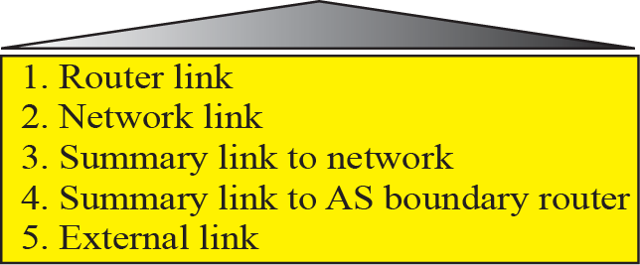
Types of OSPF packet

Slide 66
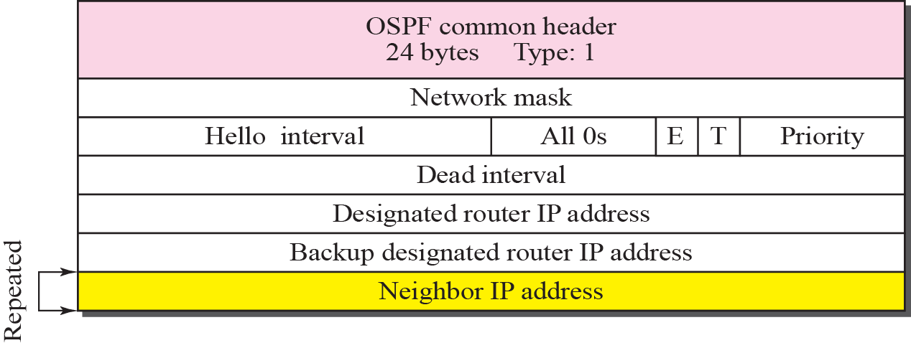
Hello packet
OSPF uses the hello message to create neighborhood relationship and to test the reachability of neighbors.
This is the first step in link state routing. Before a router can flood all of the other routers with information about its neighbors, it must first greet it neighbors.

Slide 67
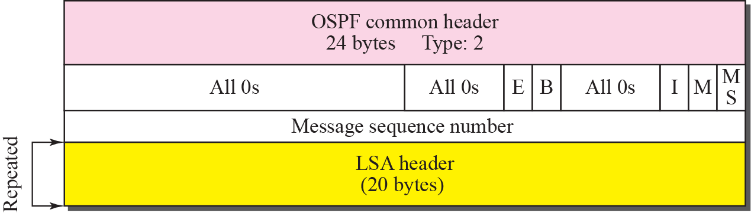
Database description packet
When a router is connected to the system for the first time or after a failure, it needs the complete link state database immediately. Therefore, it sends hello packets to greet its neighbors. If this is the first time that the neighbors hear from the router, they send a database description message.
The database description packet does not contain complete database information; it only gives an outline, the title of each lines in the database.

Slide 68
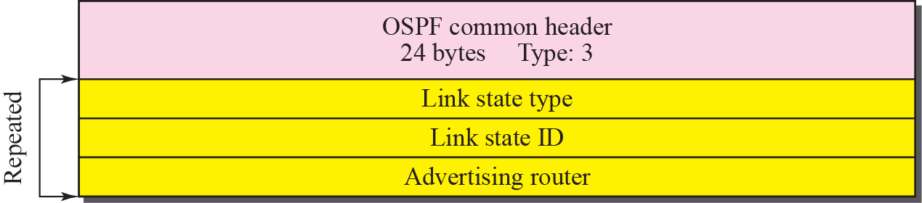
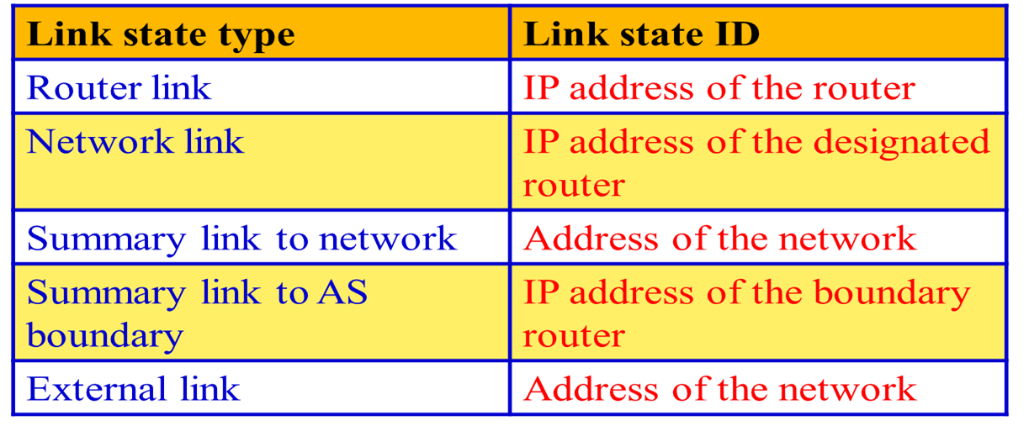
Link state request packet

Slide 69
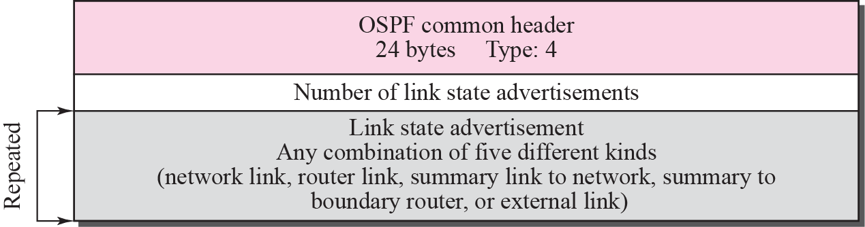

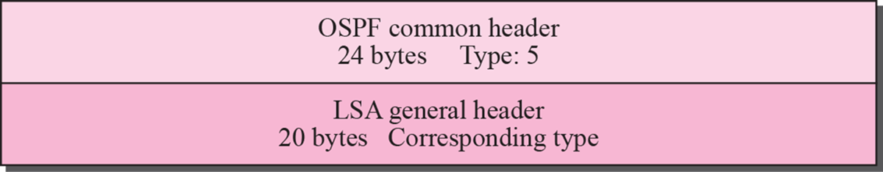
Link state update packet

Slide 70
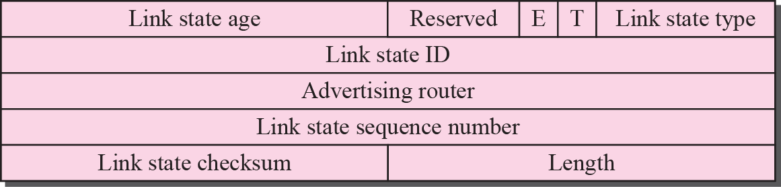
LSA general header

Slide 71
LSA General Header
Link state age
When a router creates the message, the value of this field is 0
When each successive router forwards this message, it estimates the transit time and adds it to the cumulative value of this field
E flag
If this flag is set to 1, it means the area is a stub area (an area that is connected to the backbone area by only one path
T flag
If this flag is set to 1, it means the router can handle multiple types of services
Advertising router
The IP address of the router advertising this message
Link state sequence number
A sequence number assigned to each link state update message

Slide 72
EIGRP
“Enhanced” Interior Gateway Routing Protocol
Cisco proprietary, released in 1994
Developed from the older IGRP (classful)
EIGRP is classless, supports VLSM, CIDR
EIGRP is an advanced distance-vector routing protocol that relies on features commonly associated with link-state protocols. (sometimes called a hybrid routing protocol).
RIP, IGRP, EIGRP
RIP is a typical distance vector routing protocol enhancements for better performance using hop count as metric, max 15.
IGRP was introduced to have a better metric and not be restricted to 15 hops. It is a typical distance vector routing protocol, and classful.
EIGRP was introduced to be classless and with.

Slide 73
IGRP EIGRP
Bellman-Ford algorithm
Ages out routing entries
Sends periodic updates
Keeps best routes only
Slow convergence with holddown timers
Diffusing Update Algorithm (DUAL)
Does not age out entries
No periodic updates
Keeps backup routes
Faster convergence, no holddown timers

Slide 74
IGRP and EIGRP: A migration path
IGRP | EIGRP
Classful Routing Protocol | Classless Routing Protocol VLSM, CIDR
bandwidth = (10,000,000/bandwidth kbps) delay = delay/10 24 bit metric for bandwidth and delay | bandwidth = (10,000,000/bandwidth kbps) * 256 delay = (delay/10) * 256 32 bit metric for bandwidth and delay
Maximum Hop Count = 255 | Maximum Hop Count = 224
No differentiation between internal and external routes. | Outside routes (redistributed) are tagged as external routes.
Automatic redistribution between IGRP and EIGRP as long as “AS” numbers are the same.

Slide 75
Encapsulation
Frame header
IP packet header
EIGRP packet header
Type/ length/ value data
If Ethernet, destination MAC address multicast 01-00-5E-00-00-0A.
Opcode AS number
EIGRP Parameters, IP Internal Routes, IP External Routes.
Protocol field 88 destination address multicast 224.0.0.10.

Slide 76
EIGRP packet header
EIGRP packet header
Opcode specifies packet type: Update, Query, Reply, Hello
Autonomous system (AS) number specifies the EIGRP process. Several can run at the same time.
Other fields allow for reliability if needed.

Slide 77
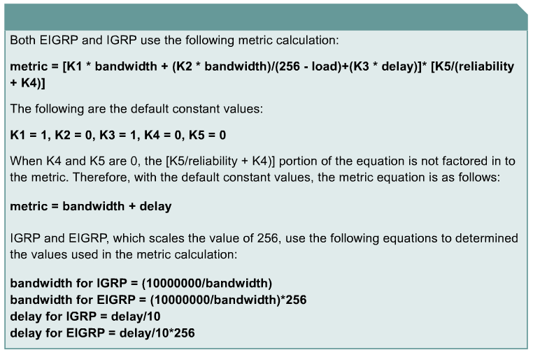
Metric Calculation (Review)
k1 for bandwidth
k2 for load
k3 for delay
k4 and k5 for Reliability
Router(config-router)# metric weights tos k1 k2 k3 k4 k5
EIGRP
bandwidth is in kbps

Slide 78
Features of EIGRP
Classless Routing Protocol (VLSM, CIDR)
Faster convergence times and improved scalability
Rapid Convergence and Better handling of routing loops – (DUAL) (coming)
Efficient Use of Bandwidth
Partial, bounded updates: Incremental updates only to the routers that need them.
Minimal bandwidth consumption: Uses Hello packets and EIGRP packets by default use no more that 50% of link’s bandwidth EIGRP packets.
PDM (Protocol Dependent Module)
Keeps EIGRP is modular
Different PDMs can be added to EIGRP as new routed protocols are enhanced or developed: IPv4, IPv6, IPX, and AppleTalk

Slide 79

Hello packets
Used by EIGRP to discover neighbours
Used to form adjacencies with neighbours.
Multicasts
Unreliable delivery
Hello
Hello

Slide 80
Update packets
Used to propagate routing information.
No periodic updates.
Sent only when necessary.
Include only required information
Sent only to those routers that require it.
Reliable delivery.
Multicast if to several routers, unicast if to one router.

Slide 81
Update packets
EIGRP updates are sent only when a route changes.
EIGRP updates are partial. They include only information about the changed route.
EIGRP updates are bounded. They go only to routers that are affected by the change.
This keeps updates small and saves bandwidth.

Slide 82
Acknowledgement (ACK) packets
Sent when reliable delivery is used by RTP.
Sent in response to update packets.
Unreliable delivery
Unicast
Update (reliable)
ACK (unreliable)

Slide 83
Query packet
Used when searching for a network
E.g. a route goes down. Is there another route?
Uses reliable delivery so requires ACK
Multicast or unicast
All neighbours must reply
Query (reliable)
ACK (unreliable)

Slide 84
Reply packet
Sent in response to a query from a neighbour.
Sent reliably so requires ACK.
Unicast
Query (reliable)
ACK (unreliable)
Reply (reliable)
ACK (unreliable)

Slide 85
Summary of message types
 | Unicast | Multicast | Either
Reliable | Reply |  | Update Query
Unreliable | ACK | Hello

Slide 86
EIGRP Terminology
Neighbor table – Each EIGRP router maintains a neighbor table that lists adjacent routers. This table is comparable to the adjacency database used by OSPF. There is a neighbor table for each protocol that EIGRP supports.
Topology table – Every EIGRP router maintains a topology table for each configured network protocol. This table includes route entries for all destinations that the router has learned. All learned routes to a destination are maintained in the topology table.
Routing table – EIGRP chooses the best routes to a destination from the topology table and places these routes in the routing table. Each EIGRP router maintains a routing table for each network protocol.

Slide 87
Successor – A successor is a route selected as the primary route to use to reach a destination. Successors are the entries kept in the routing table. Multiple successors for a destination can be retained in the routing table.
Feasible successor – A feasible successor is a backup route. These routes are selected at the same time the successors are identified, but are kept in the topology table. Multiple feasible successors for a destination can be retained in the topology table.

Slide 88
Neighbor Table
Whenever a new neighbor is discovered, the address of that neighbor and the interface used to reach it are recorded in a new neighbor table entry.
RouterC#show ip eigrp neighbors
IP-EIGRP neighbors for process 44
H Address Interface Hold Uptime SRTT RTO Q Seq
(sec) (ms) Cnt Num
0 192.168.0.1 Se0 11 00:03:09 1138 5000 0 6
1 192.168.1.2 Et0 12 00:34:46 4 200 0 4

Slide 89
Neighbor Table
RouterC#show ip eigrp neighbors
IP-EIGRP neighbors for process 44
H Address Interface Hold Uptime SRTT RTO Q Seq
(sec) (ms) Cnt Num
0 192.168.0.1 Se0 11 00:03:09 1138 5000 0 6
1 192.168.1.2 Et0 12 00:34:46 4 200 0 4
Neighbor address The network-layer address of the neighbor router(s).
Queue count The number of packets waiting in queue to be sent. If this value is constantly higher than zero, then there may be a congestion problem at the router. A zero means that there are no EIGRP packets in the queue.

Slide 90
Neighbor Table
RouterC#show ip eigrp neighbors
IP-EIGRP neighbors for process 44
H Address Interface Hold Uptime SRTT RTO Q Seq
(sec) (ms) Cnt Num
0 192.168.0.1 Se0 11 00:03:09 1138 5000 0 6
1 192.168.1.2 Et0 12 00:34:46 4 200 0 4
Smooth Round Trip Timer (SRTT) The average time it takes to send and receive packets from a neighbor.
This timer is used to determine the retransmit interval (RTO)
Hold Time The interval to wait without receiving anything from a neighbor before considering the link unavailable.
Originally, the expected packet was a hello packet, but in current Cisco IOS software releases, any EIGRP packets received after the first hello will reset the timer.

Slide 91
Topology Table
EIGRP uses its topology table to store all the information it needs to calculate a set of distances and vectors to all reachable destinations.
RouterB#show ip eigrp topology
IP-EIGRP Topology Table for process 44
Codes: P - Passive, A - Active, U - Update, Q - Query, R - Reply, r - Reply status
P 206.202.17.0/24, 1 successors, FD is 2195456
via 206.202.16.1 (2195456/2169856), Ethernet0
P 206.202.18.0/24, 2 successors, FD is 2198016
via 192.168.0.2 (2198016/284160), Serial0
via 206.202.16.1 (2198016/2172416), Ethernet0

Slide 92
Topology Table
RTX#sh ip eigrp top 204.100.50.0
IP-EIGRP topology entry for 204.100.50.0/24
State is Passive, Query origin flag is 1, 1 Successor(s), FD is 2297856
Routing Descriptor Blocks:
10.1.0.1 (Serial0), from 10.1.0.1, Send flag is 0x0
Composite metric is (2297856/128256), Route is External
Vector metric:
Minimum bandwidth is 1544 Kbit
Total delay is 25000 microseconds
Reliability is 255/255
Load is 1/255
Minimum MTU is 1500
Hop count is 1
External data:
Originating router is 192.168.1.1
AS number of route is 0
External protocol is Connected, external metric is 0
Administrator tag is 0 (0x00000000)
FD/RD

Slide 93
IP Routing Table
EIGRP chooses the best routes (that is, successor) to a destination from the topology table and places these routes in the routing table.
Each EIGRP router maintains a topology table for each network protocol.
EIGRP displays both internal EIGRP routes and external EIGRP routes.
RouterB#show ip route
Codes: C - connected, S - static, I - IGRP, R - RIP, M - mobile, B - BGP
D - EIGRP, EX - EIGRP external, O - OSPF, IA - OSPF inter area
E1 - OSPF external type 1, E2 - OSPF external type 2, E - EGP
i - IS-IS, L1 - IS-IS level-1, L2 - IS-IS level-2, * - candidate default U - per-user static route
Gateway of last resort is not set
C 10.1.1.0 is directly connected, Serial0
D 172.16.0.0 [90/2681856] via 10.1.1.0, Serial0
D EX 192.168.1.0 [170/2681856] via 10.1.1.1, 00:00:04, Serial0

Slide 94
IP Routing Table
The routing table contains the routes installed by DUAL as the best loop-free paths to a given destination.
EIGRP will maintain up to four routes per destination.
These routes can be of equal, or unequal cost (if using the variance command). (later)
RouterB#show ip route
Codes: C - connected, S - static, I - IGRP, R - RIP, M - mobile, B - BGP
D - EIGRP, EX - EIGRP external, O - OSPF, IA - OSPF inter area
E1 - OSPF external type 1, E2 - OSPF external type 2, E - EGP
i - IS-IS, L1 - IS-IS level-1, L2 - IS-IS level-2, * - candidate default U - per-user static route
Gateway of last resort is not set
C 10.1.1.0 is directly connected, Serial0
D 172.16.0.0 [90/2681856] via 10.1.1.0, Serial0
D EX 192.168.1.0 [170/2681856] via 10.1.1.1, 00:00:04, Serial0

Slide 95
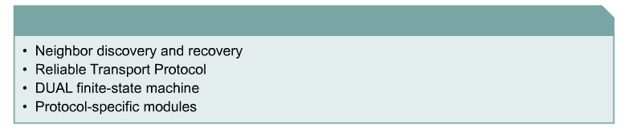
EIGRP Technologies
Four key technologies set EIGRP apart from IGRP

Slide 96
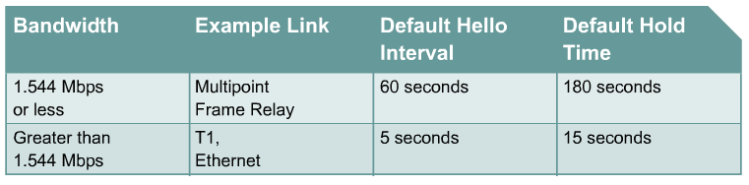
Hello Intervals and Default Hold Times
Hello Time The interval of Hello Packets
Hold Time The interval to wait without receiving anything from a neighbor before considering the link unavailable.

Slide 97
DUAL FSM
The centerpiece of EIGRP is DUAL, the EIGRP route-calculation engine.
The full name of this technology is DUAL finite state machine (FSM).
This engine contains all the logic used to calculate and compare routes in an EIGRP network.
What is FSM?
An FSM is an abstract machine, not a mechanical device with moving parts.
FSMs define a set of possible states something can go through, what events causes those states, and what events result from those states.
Designers use FSMs to describe how a device, computer program, or routing algorithm will react to a set of input events.

Slide 98


FSM Example
States such as Passive and Active trigger Certain Events

Slide 99
DUAL FSM
DUAL selects alternate routes quickly by using the information in the EIGRP tables.
If a link goes down, DUAL looks for a feasible successor in its neighbor and topology tables.
A successor is a neighboring router that is currently being used for packet forwarding, provides the least-cost route to the destination, and is not part of a routing loop.
Feasible successors provide the next lowest-cost path without introducing routing loops.
Feasible successor routes can be used in case the existing route fails; packets to the destination network are immediately forwarded to the feasible successor, which at that point, is promoted to the status of successor.
Selects a best loop-free path to a destination, the next hop being known as the successor.
All other routers to the same destination, that also meet the feasible condition, meaning they are also loop-free (later), become feasible successors, or back-up routes.
debug eigrp fsm

Slide 100
What if the successor fails?
Feasible Successor exists:
If current successor route fails, feasible successor becomes the current successor, i.e. the current route.
Routing of packets continue with little delay.
No Feasible Successor exists:
This may be because the Reported Distance is greater than the Feasible Distance.
Before this route can be installed, it must be placed in the active state and recomputed.
Routing of packets continue but with more of a delay.

Slide 101
BGP
Border Gateway Protocol (BGP) is an interdomain routing protocol using path vector routing. It first appeared in 1989 and has gone through four versions.
Types of AS:
Stub AS
A stub AS has only one connection to another AS.
The interdomain data traffic in a stub AS can be either created or terminated in the AS.
The host in the AS can send/Receive data traffic/coming form other ASs.
Data traffic cannot pass through a stub AS. A stub AS is either a source or a sink.

Slide 102
2. Multihomed AS
It has more than one connection to other ASs, but it is still only a source or a sink.
It can send/receive data traffic from/to more than one AS.
It does not allow data coming from one AS and going to another AS to pass through.
3. Transit AS
It allows transient traffic.
Path attributes
The path was presented as a list of attributes. Each attribute give some information about the path.
The list of attributes helps the receiving router make a more informed decision when applying its policy.

Slide 103
Attributes
Well known
Optional
Mandatory
Discretionary
Transitive
Non Transitive

Slide 104
Well Known- one that every BGP router must recognize.
Optional- one that needs not be recognized by every router.
Well known mandatory- one that must appear in the description of a route.
Well known Discretionary- one that must be recognized by each router.
Optional Transitive – one that must be passed to the next router by the router that has not implemented this attribute
Optional Non Transitive – one that must be discarded if the receiving router has not implemented.

Slide 105
BGP Sessions
The exchange of routing information between two routers using BGP takes place in a session.
A session is a connection that is established between two BGP routers only for the sake of exchanging routing information.
To create a reliable environment, BGP uses the services of TCP.
When a TCP connection is created for BGP, it can last for a long time, until something unusual happens.
For this reason, BGP sessions are sometimes referred to as semi permanent connections.

Slide 106
External and Internal BGP
If we want to be precise, BGP can have two types of sessions: external BGP (E-BGP) and internal BGP (I-BGP) sessions.
The E-BGP session is used to exchange information between two speaker nodes belonging to two different autonomous systems.
The IBGP session is used to exchange routing information between two routers inside an autonomous system.
The session established between AS1 and AS2 is an E-BGP session. The two speaker routers exchange information they know about networks in the Internet.
However, these two routers need to collect information from other routers in the autonomous systems. This is done using I-BGP sessions.

Slide 107


Internal and external BGP sessions

Slide 108



Types of BGP messages

Slide 109
Packet Format
All BGP packets share the same common header.
The fields of this header are as follows:
❑ Marker. The 16-byte marker field is reserved for authentication.
❑ Length. This 2-byte field defines the length of the total message including the header.
❑ Type. This 1-byte field defines the type of the packet.

Slide 110

Open message
To create a neighborhood relationship, a router running BGP opens a TCP connection with a neighbor and sends an open message. If the neighbor accepts the neighborhood relationship, it responds with a keepalive message, which means that a relationship has been established between the two routers.
❑ Hold time. This 2-byte field defines the maximum number of seconds that can elapse until one of the parties receives a keepalive or update message from the other. If a router does not receive one of these messages during the hold time period, it considers the other party dead.

Slide 111
BGP identifier. This 4-byte field defines the router that sends the open message. The router usually uses one of its IP addresses (because it is unique) for this purpose.
Option length. The open message may contain some option parameters. In this case, this 1-byte field defines the length of the total option parameters. If there are no option parameters, the value of this field is zero.
Option parameters. If the value of the option parameter length is not zero, it means that there are some option parameters. Each option parameter itself has two subfields: the length of the parameter and the parameter value. The only option parameter defined so far is authentication.

Slide 112

Update message
The update message is the heart of the BGP protocol. It is used by a router to withdraw destinations that have been advertised previously, announce a route to a new destination, _{or both..}

Slide 113
Unfeasible routes length. This 2-byte field defines the length of the next field.
Withdrawn routes. This field lists all the routes that must be deleted from the previously advertised list.
Path attributes length. This 2-byte field defines the length of the next field.
Network layer reachability information (NLRI). This field defines the network that is actually advertised by this message. It has a length field and an IP address prefix. The length defines the number of bits in the prefix. The prefix defines the common part of the network address

Slide 114


_{Keepalive message}
_{Notification message}
A notification message is sent by a router whenever an error condition is detected or a router wants to close the connection

